Slide 1

2026 IOA Conference Presenter Resources
2026 IOA Conference Presenter Resources

Slide 2

Welcome to #IOA2026
We look forward to working with you this year!

Slide 3


HOW TO PREPARE
Review All Provided Materials
We are delighted that you will be presenting at the 21st Annual IOA Conference. We have provided you with the resources in this kit to assist you in preparing your presentation.
Be sure you are set up for success. Review the provided speaker resources information on the IOA Conference website
Speaker Resources

Slide 4

EVENT INFORMATION
Global Engagement & Time Zone Access
All times on the schedule below are listed in Pacific Time. If you need help converting to your time zone, try out World Time Buddy
Learn More on the Conference Website
IOA’s 21st Annual Conference will be taking place online 13-15 April 2027.
View Conference Schedule
View Conference Website

Slide 5

IMPORTANT DATES
15, December 2025 | Completed Speaker Agreements Due.
13, March 2026 | Any slides and handouts due to the IOA office.
Slides must be in PPT or PDF format.
Handouts must be in JPG/JPEG, 24-bit PNG, PDF, or PPT. To be made available to attendees. Maximum upload single file size: 15 MB.
Please save files as “Speaker Last Name_Session Title”.
13, March 2026 | Any polling questions due to the IOA office.

Slide 6
Technology Overview
Zoom Events, Our Virtual Venue

Slide 7

Virtual Venue
#IOA2026 will be hosted on Zoom Events
All speakers will be emailed an invitation to join the Zoom event (this will be done once you’ve registered for the conference).
Enter the event by pressing “view ticket”. This will take you to the Zoom event. You will need to make sure you are logged into Zoom with the same email you used to register for the conference.
Once you are in the Zoom event, press “ Join Lobby.” You will then see all the ongoing talks and the sessions in which you are assigned as a speaker.
View Tutorial
Notes:
Need to add

Slide 8

SPEAKER TRAINING
Attendance is mandatory; please add one or both options below to your calendar.
Option One
Monday, 30 March
4:00 PM PT
Option Two
Thursday, 2 April
8:00 AM PT
Add to Calendar
Add to Calendar
Notes:
Need to add

Slide 9
COMPUTER REQUIREMENTS
Use speedtest.net to test the bandwidth speed of your computer.
Desktop web browser:
Chromium Edge: 80 or higher
Google Chrome: 53.0.2785 or higher
Safari: 10.0.602.1.50 or higher
Firefox: 76 or higher
Internet Explorer: 10 or higher
Basic, Pro, Business, Enterprise, or Education Zoom account
Zoom desktop client for Windows, macOS, or Linux: Global minimum version or higher
Zoom mobile app for Android or iOS: Global minimum version or higher
Note: For attendee access to the latest Zoom Events and Webinar features, we highly encourage attendees to update to the latest version of the Zoom desktop client/mobile application.
Update Zoom
Run Speed Test

Slide 10
ADDITIONAL ITEMS
• Disable pop-up blockers in your Internet browser settings.
• A wired connection is recommended. Wi-Fi signal strengths can vary, causing bandwidth to increase or decrease. A wired connection gives a consistent signal and consistent bandwidth.
• Audio (sound) is projected through your computer speakers. Be sure your computer is equipped with speakers, you are using a headset, or the room where the conference is being broadcast is equipped with speakers, so you can hear the presenters.

Slide 11
TIPS & TRICKS FOR VIRTUAL
Video/Visual
• Check your lighting. It’s best to have light in front of you.
• Dress to present. Avoid busy patterned shirts.
• Avoid a busy background.
Audio
• Turn off all electronics unless they’re being utilized in your presentation. If possible, use a headset or earbuds with a microphone.
• Turn off all computer notifications.
• Call into the presentation with your phone. If your internet goes out, you will still be able to speak and be heard by attendees.
Set Up for Success
Ensure all notifications are silenced. Close computer applications such as email or Slack that may cause notifications to appear.
Tell Us Your Name
• You can edit your name as it is displayed to other participants. Here’s how: In Zoom, select the three dots in the right-hand corner of your Zoom video frame. Select “rename” to adjust your name accordingly.

Slide 12
What to Expect During Your Presentation
You’re Going to Do A Great Job!

Slide 13
BEFORE YOUR SESSION
• Please enter your session 15 minutes before the start of your session.
From the event lobby, scroll down to where it says “in progress.” You will see a small badge that says speaker and a small button that says join.
Select “join,” and you will enter the backstage area of your session.
• While in Backstage, you and your co-presenters can practice your presentation and interact without attendees being able to see.
• This allows you to test your mic, video, and sharing screen before the session.
• Attendees will be allowed into the virtual room 1 minute before the session starts. At that point, they will be able to see and hear presenters.
When your session is ready to begin, you can leave backstage and begin the session by selecting “start”.
View Tutorial
Notes:
Need to add

Slide 14
SESSION HOSTS
• Both will start your session 15 minutes before your session start time to create the green room.
• You can join your sessions “backstage” and communicate with IOA and your session host to make sure that your audio, mic, etc. are working correctly.
Chat with the IOA office will be enabled in case of technical difficulties.
• Your session host will do a brief introduction at the start of the session to start. Once introduced, speakers can begin.
Notes:
Need to add

Slide 15
DURING YOUR SESSION
Your Session host will give a brief introduction to your session.
If you are using visual aids during your session, you can share your screen (see instructions on the next page).
If you are having issues sharing your visual aids and send the IOA office a copy in advance. Either you or your session host can chat with the IOA office and ask for assistance sharing your slides.
Any handouts provided for your session can be found in the event lobby.

Slide 16
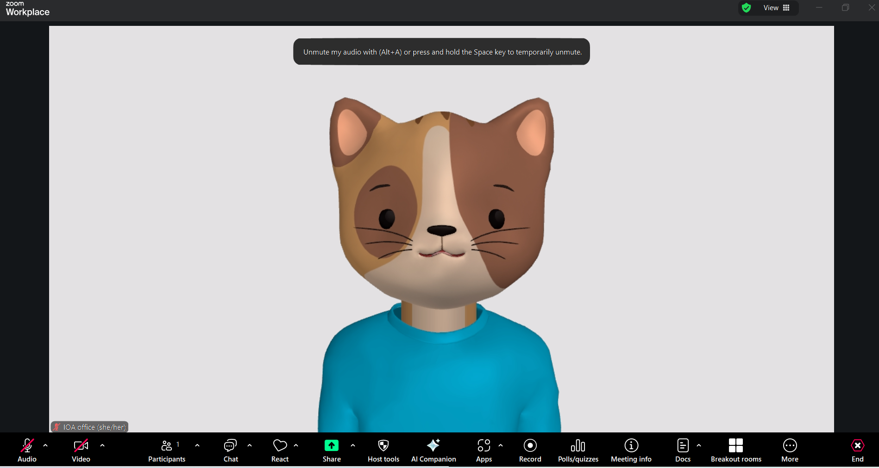
Sharing your Screen
Double-check that your camera and mic are on! If there is a red slash through the icon (as seen in the photo), then your video and camera are off.
Notes:
I forgot if Ellen gave us the Thumbs up on Q&A- They can ask questions to a host or co-host (Megan)

Slide 17
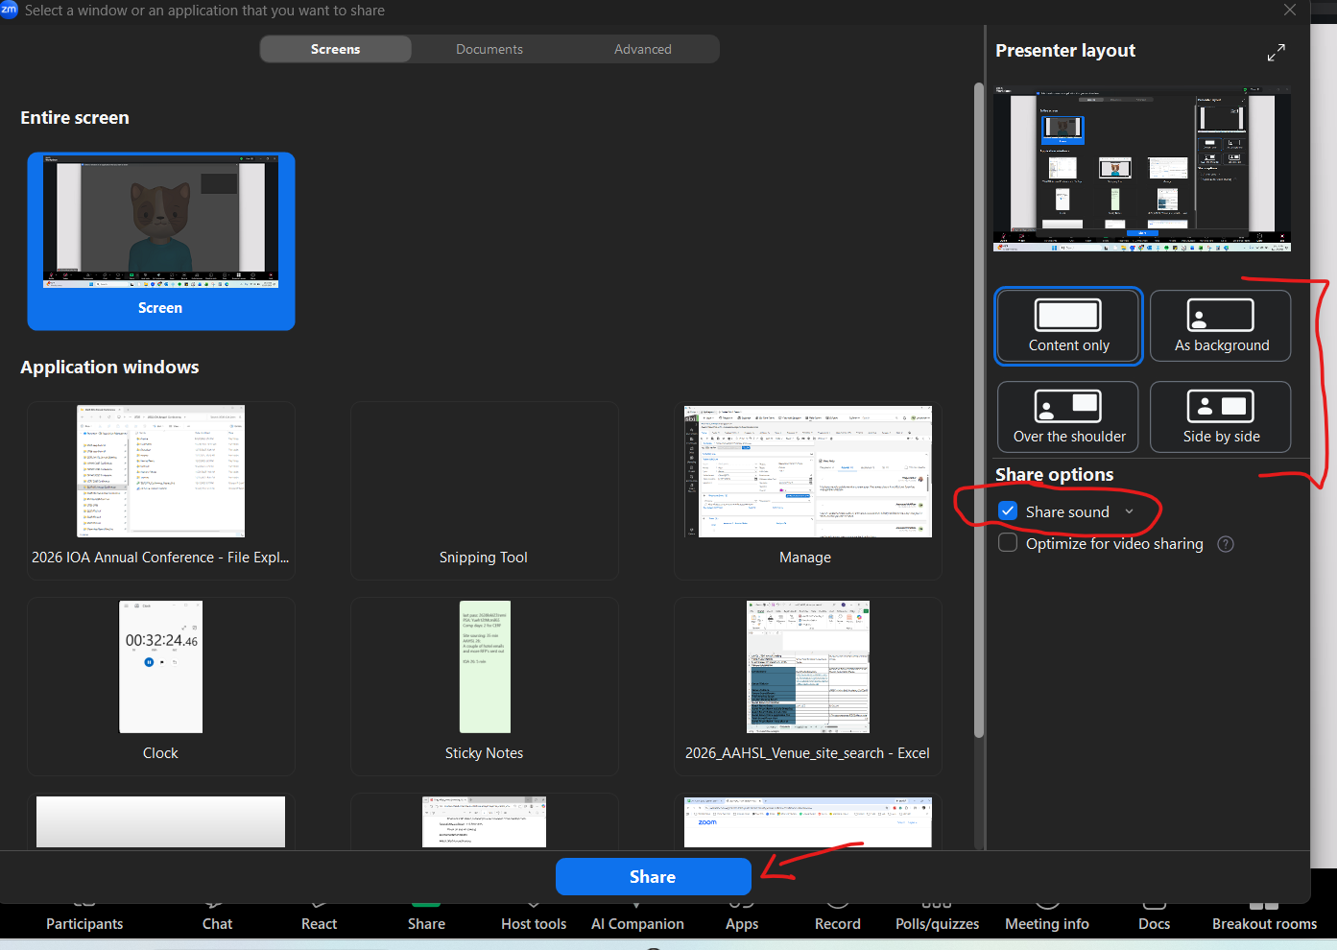
Sharing your Screen
If you are sharing a presentation or video that has sound, make sure to select “Share sound” when sharing your screen.
Notes:
I forgot if Ellen gave us the Thumbs up on Q&A- They can ask questions to a host or co-host (Megan)

Slide 18
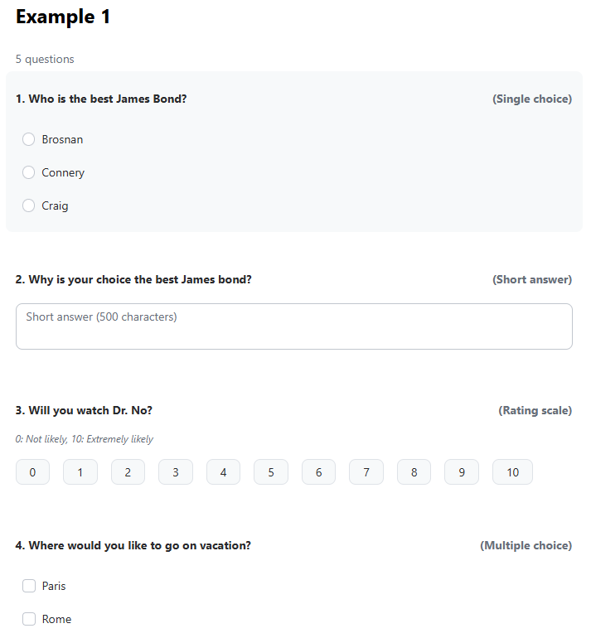
POLLING QUESTIONS
Any polling questions that you would like to have included in your session must be emailed to the IOA office no later than 13 March 2026.
Question types:
Single Choice
Multiple Choice
Short Answer
Long Answer
Rating Scale
Polling questions must be set up in advance of the event. Questions sent after 13 March will not be guaranteed to be on the platform.

Slide 19
CHAT AND Q&A
•Attendee chat will be disabled in the Zoom Event platform (don’t worry, you will have plenty of time to catch up with attendees and network in Gathertown!).
The IOA Office, Host, Speakers, and those with special permissions will be able to chat in Zoom events to help troubleshoot any issues that arise. If you need assistance, simply send a chat to “IOA Office.”
Notes:
I forgot if Ellen gave us the Thumbs up on Q&A- They can ask questions to a host or co-host (Megan)

Slide 20
CONTACT IOA
(206) 209-5275 | info@ombudsassociation.org
Business Hours: Monday – Friday, 8:30 AM – 5:00 PM (Pacific Time)

